Slide 1
Qt编程 实验目录
1.实验内容
2.实验目的
3.实验平台
4.程序完成指标
5.实验参考
6.实验步骤
7.参考程序
8.思考题

Slide 2
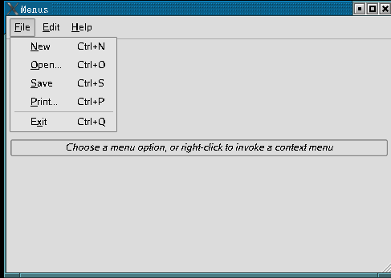
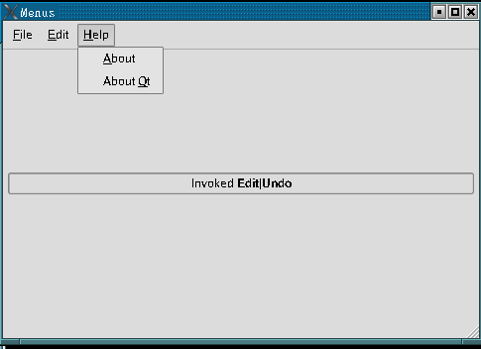
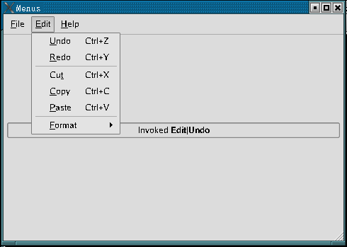
Qt编程 一、实验内容
编写Qt程序，实现一个包含菜单、Qwidget、QLabel、Qwidget的窗口，如图,
执行命令时，在Qlable上显示与菜单命令相关的提示文字。
要求：
(1)程序在FS6818M4实验箱上运行

Slide 3
Qt编程 二、实验目的
1.学习掌握QMenuBar、Qmenu、QAction的菜单编程方法和技巧。
2.学习掌握信息框辅助调试的编程方法与技巧。

Slide 4
Qt编程 三、实验平台
1.硬件
计算机 1台
FS_6818M4_V2实验箱 1台
2.软件
(1)台式计算机
操作系统： Windows10
虚拟机: VMware-player-15.1.0
Ubuntu18.04
ubuntu-18.04-64bit_farsight(包含Qt,ARM-Qt)
超级终端：PUTTY.EXE
(2) FS_6818M4_V2实验箱
嵌入式Linux操作系统

Slide 5
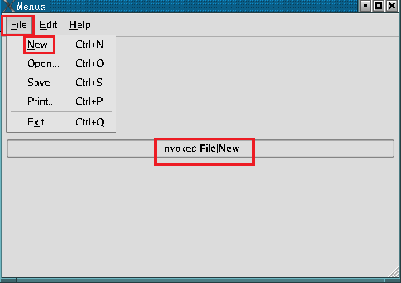
Qt编程 四、实验完成指标
运行程序，显示带菜单和标签的窗口，反复执行菜单命令，标签显示与菜单命令有关的提示信息.

Slide 6
Qt编程 五、实验参考
1.QWidget、QLable、Qwidget 3个控件在窗口内的摆放
(1)创建一个Qwidget小部件对象,放置屏幕中心
QWidget *widget = new QWidget;
setCentralWidget(widget);
(2)创建QWidget、QLable、Qwidget对象
QWidget *topFiller = new QWidget;
Qlabel infoLabel = new QLabel(tr("<i>Choose a menu option, or right-click to "
"invoke a context menu</i>"));
QWidget *bottomFiller = new QWidget;
(3)创建一个垂直布局对象，并且以此加入topFiller、 infoLabel 、 infoLabel，将此3个组件垂直方向摆放
QVBoxLayout *layout = new QVBoxLayout;
layout->addWidget(topFiller);
layout->addWidget(infoLabel);
layout->addWidget(bottomFiller);
(4) Widget配置为垂直布局
widget->setLayout(layout);

Slide 7
Qt编程 五、实验参考
2.创建菜单:以创建Help|about为例,讲述菜单创建过程
(1)创建Qaction 类变量并实例化
QAction aboutAct = new QAction(tr(“&About”), this); //创建对象，子菜单名”About”
aboutAct->setStatusTip(tr(“Show the application‘s About box”));
connect(aboutAct, SIGNAL(triggered()), this, SLOT(about())); //选择Help|About,生成triggered()信号
//建立信号triggered()与槽about()关联
//这样选择Help|About，会调用about()
(2)在菜单栏增加”Help”菜单以及“About”子菜单
helpMenu = menuBar()->addMenu(tr(“&Help”)); // menuBar()返回状态栏，在菜单栏增加Help菜单
helpMenu->addAction(aboutAct); //向菜单Help增加Action,即增加aboutAct
(3)槽函数about():选中此菜单时，执行槽about(),显示一个带有信息的对话框
void MainWindow::about()
{
infoLabel->setText(tr("Invoked <b>Help|About</b>"));
QMessageBox::about(this, tr(“About Menu”), //信息提示对话框
tr("The <b>Menu</b> example shows how to create "
"menu-bar menus and context menus."));
}

Slide 8
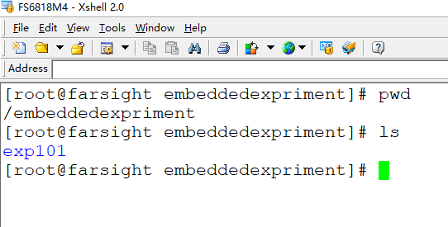
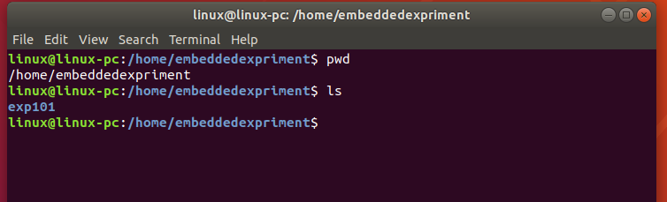
Qt编程 六、实验步骤
1.确认编程环境准备好
(1).确认VM ubuntu18.04已经启动
(2).确认实验箱已经启动
如果没有准备好，参考实验1.1，
安装实验1.1步骤启动ubuntu18.04和实验箱

Slide 9
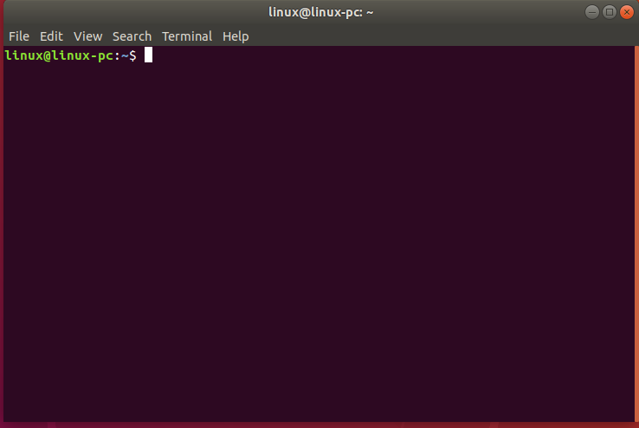
Qt编程 六、实验步骤
2.ubuntu18.04下，进入“终端”,如果已经进入，略过此步,
在ubuntu18.04操作主窗口，按组合键CTRL+ALT+T,进入终端窗口

Slide 10
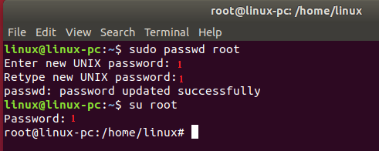
Qt编程 六、实验步骤
3.切换到root,如果已经进入root，略过此步,
linux@linux-pc:~$ sudo passwd root
Enter new UNIX password: 1
Retype new UNIX password: 1
passwd: password updated successfully
linux@linux-pc:~$ su root
Password: 1
root@linux-pc:/home/linux#

Slide 11
Qt编程 六、实验步骤
4.编程
(1)进入 /home/embeddedexpriment目录
(2)创建实验4的第2个小实验实验目录exp402
# mkdir exp402
# cd exp402
# pwd
/home/embeddedexpriment/exp402

Slide 12
Qt编程 六、实验步骤
(3)在exp402下编写程序
root@linux-pc:/home/embeddedexpriment/exp402# vim mainwindow.h
root@linux-pc:/home/embeddedexpriment/exp402# vim mainwindow.cpp
root@linux-pc:/home/embeddedexpriment/exp402# vim main.cpp
root@linux-pc:/home/embeddedexpriment/exp402# ls
main.cpp mainwindow.cpp moc_mainwindow.cpp mainwindow.h
root@linux-pc:/home/embeddedexpriment/exp402#

Slide 13
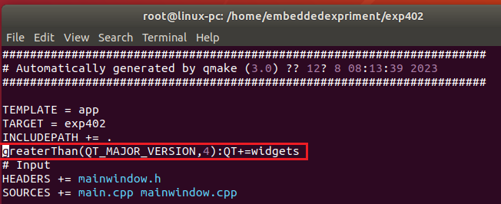
Qt编程 六、实验步骤
(4)使用qmake生成exp402.pro、Makefile,并对exp402.pro修改
/exp402# ls
main.cpp mainwindow.cpp moc_mainwindow.cpp mainwindow.h
/exp402# /opt/qt/bin/qmake -project
/exp402# /opt/qt/bin/qmake
main.cpp mainwindow.cpp
exp402.pro mainwindow.h Makefile
/exp402# vim exp402.pro
/exp402#

Slide 14
Qt编程 六、实验步骤
5.编译、链接
root@linux-pc:/home/embeddedexpriment/exp402# ls
main.cpp mainwindow.cpp exp402.pro mainwindow.h
Makefile
root@linux-pc:/home/embeddedexpriment/exp402# vim exp401.pro
root@linux-pc:/home/embeddedexpriment/exp402# make
root@linux-pc:/home/embeddedexpriment/exp402# ls
exp402 main.cpp mainwindow.cpp mainwindow.o moc_mainwindow.cpp
exp402.pro main.o mainwindow.h Makefile moc_mainwindow.o
root@linux-pc:/home/embeddedexpriment/exp402#

Slide 15
Qt编程 六、实验步骤
6.exp402拷贝到/sources/rootfs/embeddedexpriment
root@linux-pc:/home/embeddedexpriment/exp402# cd /source/rootfs/embeddedexpriment/
root@linux-pc:/source/rootfs/embeddedexpriment/#cp –rf /home/embeddedexpriment/exp402/ ./
root@linux-pc:/source/rootfs/embeddedexpriment# ls
exp101 exp103 exp202 exp301 exp3021 exp401 exp403
exp102 exp201 exp203 exp302 exp303 exp402 expt101
root@linux-pc:/source/rootfs/embeddedexpriment#

Slide 16
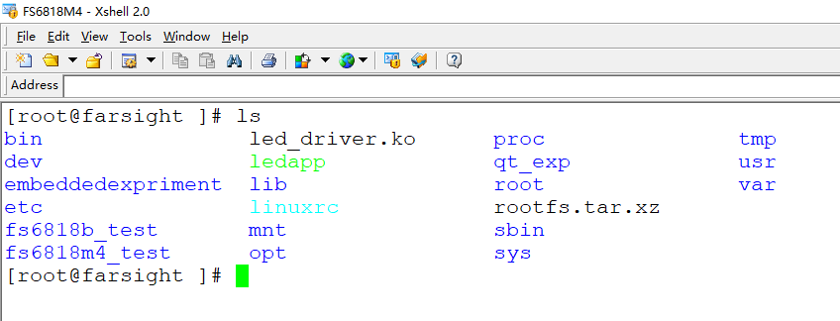
Qt编程 六、实验步骤
7.运行程序
(1)激活fs6818M4会话窗口,进入exp402目录

Slide 17
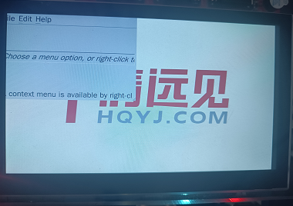
Qt编程 六、实验步骤
(2)执行程序
[root@farsight ]# ls
bin led_driver.ko proc tmp
dev ledapp qt_exp usr
embeddedexpriment lib root var
etc linuxrc rootfs.tar.xz
fs6818b_test mnt sbin
fs6818m4_test opt sys
[root@farsight ]# cd embeddedexpriment/
[root@farsight embeddedexpriment]# ls
exp101 exp103 exp202 exp301 exp3021 exp401 exp403
exp102 exp201 exp203 exp302 exp303 exp402 expt101
[root@farsight embeddedexpriment]# cd exp402/
[root@farsight exp402]# ls
Makefile main.cpp mainwindow.h moc_mainwindow.o
exp402 main.o mainwindow.o
exp402.pro mainwindow.cpp moc_mainwindow.cpp
[root@farsight exp401]# ./exp402 -qws
[ 70.721000] <<-GTP-INFO->> System resume.
[ 70.729000] <<-GTP-INFO->> GTP wakeup sleep.

Slide 18
Qt编程 七、实验参考程序
1.main.cpp主程序
#include <QApplication>
#include "mainwindow.h"
int main(int argc, char *argv[])
{
QApplication app(argc, argv);
MainWindow window;
window.show();
return app.exec();
}

Slide 19
Qt编程 七、实验参考程序
2.exp402.pro工程文件
TEMPLATE = app
TARGET = exp402
INCLUDEPATH += .
greaterThan(QT_MAJOR_VERSION,4):QT+=widgets
# Input
HEADERS += mainwindow.h
SOURCES += main.cpp mainwindow.cpp

Slide 20
Qt编程 七、实验参考程序
3. mainwindow.h
#ifndef MAINWINDOW_H
#define MAINWINDOW_H
#include <QMainWindow>
QT_BEGIN_NAMESPACE
class QAction;
class QActionGroup;
class QLabel;
class QMenu;
QT_END_NAMESPACE
class MainWindow : public QMainWindow
{
Q_OBJECT
public:
MainWindow();
protected:
void contextMenuEvent(QContextMenuEvent *event);
private slots:
void newFile();
void open();
void save();
void print();
void undo();
void redo();
void cut();
void copy();
void paste();
void bold();
void italic();
void leftAlign();
void rightAlign();
void justify();
void center();
void setLineSpacing();
void setParagraphSpacing();
void about();
void aboutQt();

Slide 21
Qt编程 七、实验参考程序
private:
void createActions();
void createMenus();
QMenu *fileMenu;
QMenu *editMenu;
QMenu *formatMenu;
QMenu *helpMenu;
QActionGroup *alignmentGroup;
QAction *newAct;
QAction *openAct;
QAction *saveAct;
QAction *printAct;
QAction *exitAct;
QAction *undoAct;
QAction *redoAct;
QAction *cutAct;
QAction *copyAct;
QAction *pasteAct;
QAction *boldAct;
QAction *italicAct;
QAction *leftAlignAct;
QAction *rightAlignAct;
QAction *justifyAct;
QAction *centerAct;
QAction *setLineSpacingAct;
QAction *setParagraphSpacingAct;
QAction *aboutAct;
QAction *aboutQtAct;
QLabel *infoLabel;
};
#endif

Slide 22
Qt编程 七、实验参考程序
4. mainwindow.cpp
#include <QtWidgets>
#include "mainwindow.h"
MainWindow::MainWindow()
{
QWidget *widget = new QWidget;
setCentralWidget(widget);
QWidget *topFiller = new QWidget;
topFiller->setSizePolicy(QSizePolicy::Expanding, QSizePolicy::Expanding);
infoLabel = new QLabel(tr("<i>Choose a menu option, or right-click to "
"invoke a context menu</i>"));
infoLabel->setFrameStyle(QFrame::StyledPanel | QFrame::Sunken);
infoLabel->setAlignment(Qt::AlignCenter);

Slide 23
Qt编程 七、实验参考程序
QWidget *bottomFiller = new QWidget;
bottomFiller->setSizePolicy(QSizePolicy::Expanding, QSizePolicy::Expanding);
QVBoxLayout *layout = new QVBoxLayout;
layout->setMargin(5);
layout->addWidget(topFiller);
layout->addWidget(infoLabel);
layout->addWidget(bottomFiller);
widget->setLayout(layout);
createActions();
createMenus();
QString message = tr("A context menu is available by right-clicking");
statusBar()->showMessage(message);
setWindowTitle(tr("Menus"));
setMinimumSize(160, 160);
resize(480, 320);
}

Slide 24
Qt编程 七、实验参考程序
void MainWindow::contextMenuEvent(QContextMenuEvent *event)
{
QMenu menu(this);
menu.addAction(cutAct);
menu.addAction(copyAct);
menu.addAction(pasteAct);
menu.exec(event->globalPos());
}
void MainWindow::newFile()
{
infoLabel->setText(tr("Invoked <b>File|New</b>"));
}

Slide 25
Qt编程 七、实验参考程序
void MainWindow::open()
{
infoLabel->setText(tr("Invoked <b>File|Open</b>"));
}
void MainWindow::save()
{
infoLabel->setText(tr("Invoked <b>File|Save</b>"));
}
void MainWindow::print()
{
infoLabel->setText(tr("Invoked <b>File|Print</b>"));
}
void MainWindow::undo()
{
infoLabel->setText(tr("Invoked <b>Edit|Undo</b>"));
}

Slide 26
Qt编程 七、实验参考程序
void MainWindow::redo()
{
infoLabel->setText(tr("Invoked <b>Edit|Redo</b>"));
}
void MainWindow::cut()
{
infoLabel->setText(tr("Invoked <b>Edit|Cut</b>"));
}
void MainWindow::copy()
{
infoLabel->setText(tr("Invoked <b>Edit|Copy</b>"));
}
void MainWindow::paste()
{
infoLabel->setText(tr("Invoked <b>Edit|Paste</b>"));
}
void MainWindow::bold()
{
infoLabel->setText(tr("Invoked <b>Edit|Format|Bold</b>"));
}

Slide 27
Qt编程 七、实验参考程序
void MainWindow::italic()
{
infoLabel->setText(tr("Invoked <b>Edit|Format|Italic</b>"));
}
void MainWindow::leftAlign()
{
infoLabel->setText(tr("Invoked <b>Edit|Format|Left Align</b>"));
}
void MainWindow::rightAlign()
{
infoLabel->setText(tr("Invoked <b>Edit|Format|Right Align</b>"));
}
void MainWindow::justify()
{
infoLabel->setText(tr("Invoked <b>Edit|Format|Justify</b>"));
}
void MainWindow::center()
{
infoLabel->setText(tr("Invoked <b>Edit|Format|Center</b>"));
}

Slide 28
Qt编程 七、实验参考程序
void MainWindow::setLineSpacing()
{
infoLabel->setText(tr("Invoked <b>Edit|Format|Set Line Spacing</b>"));
}
void MainWindow::setParagraphSpacing()
{
infoLabel->setText(tr("Invoked <b>Edit|Format|Set Paragraph Spacing</b>"));
}
void MainWindow::about()
{
infoLabel->setText(tr("Invoked <b>Help|About</b>"));
QMessageBox::about(this, tr("About Menu"),
tr("The <b>Menu</b> example shows how to create "
"menu-bar menus and context menus."));
}
void MainWindow::aboutQt()
{
infoLabel->setText(tr("Invoked <b>Help|About Qt</b>"));
}

Slide 29
Qt编程 七、实验参考程序
void MainWindow::createActions()
{
newAct = new QAction(tr("&New"), this);
newAct->setShortcut(tr("Ctrl+N"));
newAct->setStatusTip(tr("Create a new file"));
connect(newAct, SIGNAL(triggered()), this, SLOT(newFile()));
openAct = new QAction(tr("&Open..."), this);
openAct->setShortcut(tr("Ctrl+O"));
openAct->setStatusTip(tr("Open an existing file"));
connect(openAct, SIGNAL(triggered()), this, SLOT(open()));
saveAct = new QAction(tr("&Save"), this);
saveAct->setShortcut(tr("Ctrl+S"));
saveAct->setStatusTip(tr("Save the document to disk"));
connect(saveAct, SIGNAL(triggered()), this, SLOT(save()));

Slide 30
Qt编程 七、实验参考程序
printAct = new QAction(tr("&Print..."), this);
printAct->setShortcut(tr("Ctrl+P"));
printAct->setStatusTip(tr("Print the document"));
connect(printAct, SIGNAL(triggered()), this, SLOT(print()));
exitAct = new QAction(tr("E&xit"), this);
exitAct->setShortcut(tr("Ctrl+Q"));
exitAct->setStatusTip(tr("Exit the application"));
connect(exitAct, SIGNAL(triggered()), this, SLOT(close()));
undoAct = new QAction(tr("&Undo"), this);
undoAct->setShortcut(tr("Ctrl+Z"));
undoAct->setStatusTip(tr("Undo the last operation"));
connect(undoAct, SIGNAL(triggered()), this, SLOT(undo()));
redoAct = new QAction(tr("&Redo"), this);
redoAct->setShortcut(tr("Ctrl+Y"));
redoAct->setStatusTip(tr("Redo the last operation"));
connect(redoAct, SIGNAL(triggered()), this, SLOT(redo()));

Slide 31
Qt编程 七、实验参考程序
cutAct = new QAction(tr("Cu&t"), this);
cutAct->setShortcut(tr("Ctrl+X"));
cutAct->setStatusTip(tr("Cut the current selection's contents to the "
"clipboard"));
connect(cutAct, SIGNAL(triggered()), this, SLOT(cut()));
copyAct = new QAction(tr("&Copy"), this);
copyAct->setShortcut(tr("Ctrl+C"));
copyAct->setStatusTip(tr("Copy the current selection's contents to the "
"clipboard"));
connect(copyAct, SIGNAL(triggered()), this, SLOT(copy()));
pasteAct = new QAction(tr("&Paste"), this);
pasteAct->setShortcut(tr("Ctrl+V"));
pasteAct->setStatusTip(tr("Paste the clipboard's contents into the current "
"selection"));
connect(pasteAct, SIGNAL(triggered()), this, SLOT(paste()));
boldAct = new QAction(tr("&Bold"), this);
boldAct->setCheckable(true);
boldAct->setShortcut(tr("Ctrl+B"));
boldAct->setStatusTip(tr("Make the text bold"));
connect(boldAct, SIGNAL(triggered()), this, SLOT(bold()));

Slide 32
Qt编程 七、实验参考程序
QFont boldFont = boldAct->font();
boldFont.setBold(true);
boldAct->setFont(boldFont);
italicAct = new QAction(tr("&Italic"), this);
italicAct->setCheckable(true);
italicAct->setShortcut(tr("Ctrl+I"));
italicAct->setStatusTip(tr("Make the text italic"));
connect(italicAct, SIGNAL(triggered()), this, SLOT(italic()));
QFont italicFont = italicAct->font();
italicFont.setItalic(true);
italicAct->setFont(italicFont);

Slide 33
Qt编程 七、实验参考程序
setLineSpacingAct = new QAction(tr("Set &Line Spacing..."), this);
setLineSpacingAct->setStatusTip(tr("Change the gap between the lines of a "
"paragraph"));
connect(setLineSpacingAct, SIGNAL(triggered()), this, SLOT(setLineSpacing()));
setParagraphSpacingAct = new QAction(tr("Set &Paragraph Spacing..."), this);
setLineSpacingAct->setStatusTip(tr("Change the gap between paragraphs"));
connect(setParagraphSpacingAct, SIGNAL(triggered()),
this, SLOT(setParagraphSpacing()));
aboutAct = new QAction(tr("&About"), this);
aboutAct->setStatusTip(tr("Show the application's About box"));
connect(aboutAct, SIGNAL(triggered()), this, SLOT(about()));
aboutQtAct = new QAction(tr("About &Qt"), this);
aboutQtAct->setStatusTip(tr("Show the Qt library's About box"));
connect(aboutQtAct, SIGNAL(triggered()), qApp, SLOT(aboutQt()));
connect(aboutQtAct, SIGNAL(triggered()), this, SLOT(aboutQt()));

Slide 34
Qt编程 七、实验参考程序
leftAlignAct = new QAction(tr("&Left Align"), this);
leftAlignAct->setCheckable(true);
leftAlignAct->setShortcut(tr("Ctrl+L"));
leftAlignAct->setStatusTip(tr("Left align the selected text"));
connect(leftAlignAct, SIGNAL(triggered()), this, SLOT(leftAlign()));
rightAlignAct = new QAction(tr("&Right Align"), this);
rightAlignAct->setCheckable(true);
rightAlignAct->setShortcut(tr("Ctrl+R"));
rightAlignAct->setStatusTip(tr("Right align the selected text"));
connect(rightAlignAct, SIGNAL(triggered()), this, SLOT(rightAlign()));
justifyAct = new QAction(tr("&Justify"), this);
justifyAct->setCheckable(true);
justifyAct->setShortcut(tr("Ctrl+J"));
justifyAct->setStatusTip(tr("Justify the selected text"));
connect(justifyAct, SIGNAL(triggered()), this, SLOT(justify()));

Slide 35
Qt编程 七、实验参考程序
centerAct = new QAction(tr("&Center"), this);
centerAct->setCheckable(true);
centerAct->setShortcut(tr("Ctrl+E"));
centerAct->setStatusTip(tr("Center the selected text"));
connect(centerAct, SIGNAL(triggered()), this, SLOT(center()));
alignmentGroup = new QActionGroup(this);
alignmentGroup->addAction(leftAlignAct);
alignmentGroup->addAction(rightAlignAct);
alignmentGroup->addAction(justifyAct);
alignmentGroup->addAction(centerAct);
leftAlignAct->setChecked(true);
}

Slide 36
Qt编程 七、实验参考程序
void MainWindow::createMenus()
{
fileMenu = menuBar()->addMenu(tr("&File"));
fileMenu->addAction(newAct);
fileMenu->addAction(openAct);
fileMenu->addAction(saveAct);
fileMenu->addAction(printAct);
fileMenu->addSeparator();
fileMenu->addAction(exitAct);
editMenu = menuBar()->addMenu(tr("&Edit"));
editMenu->addAction(undoAct);
editMenu->addAction(redoAct);
editMenu->addSeparator();
editMenu->addAction(cutAct);
editMenu->addAction(copyAct);
editMenu->addAction(pasteAct);
editMenu->addSeparator();

Slide 37
Qt编程 七、实验参考程序
helpMenu = menuBar()->addMenu(tr("&Help"));
helpMenu->addAction(aboutAct);
helpMenu->addAction(aboutQtAct);
formatMenu = editMenu->addMenu(tr("&Format"));
formatMenu->addAction(boldAct);
formatMenu->addAction(italicAct);
formatMenu->addSeparator()->setText(tr("Alignment"));
formatMenu->addAction(leftAlignAct);
formatMenu->addAction(rightAlignAct);
formatMenu->addAction(justifyAct);
formatMenu->addAction(centerAct);
formatMenu->addSeparator();
formatMenu->addAction(setLineSpacingAct);
formatMenu->addAction(setParagraphSpacingAct);
}

